Slide 1
Advanced Neural Network
Techniques
Dr. Mongkol Ekpanyapong

Slide 2
Neural Network advanced techniques
Loss Functions
Activation functions
Optimization
Normalization

Slide 3
Loss Function
Huber Loss
Contrastive Loss
Triplet Loss

Slide 4
Huber Loss
We have L1 Loss (MAE) and L2 Loss (MSE), what if we combine them?

Slide 5
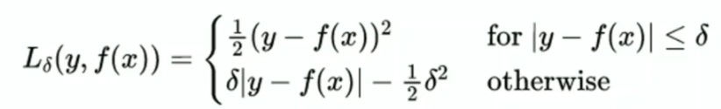
Huber Loss (Smooth L1 Loss)
Less sensitive to outliers in data
It provides smooth function better than L1
δ (delta) is a hyper parameter

Slide 6
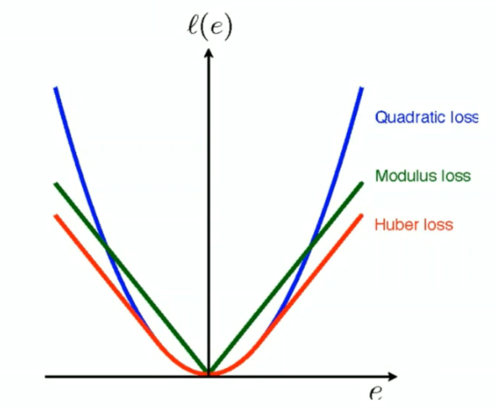
Huber Loss Comparison
Like MSE for small values, and linear for large values

Slide 7

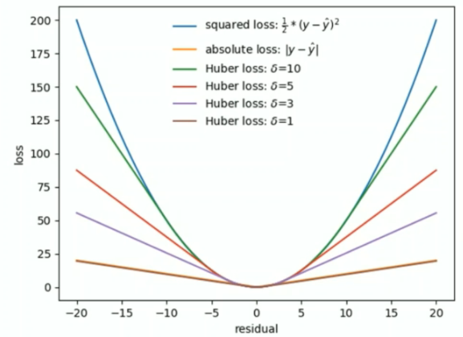
Effect of delta

Slide 8
Contrastive Loss
Compute a distance-based Loss function
It is computed based on a pair of data ( could be either positive pair or negative pair)
For example, first example of two images is the same person (positive pair)
Second example of two images is different person (negative pair)

Slide 9
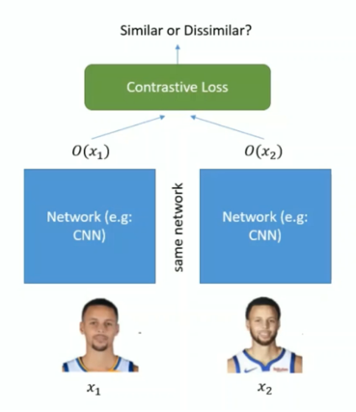
Contrastive Loss

Slide 10
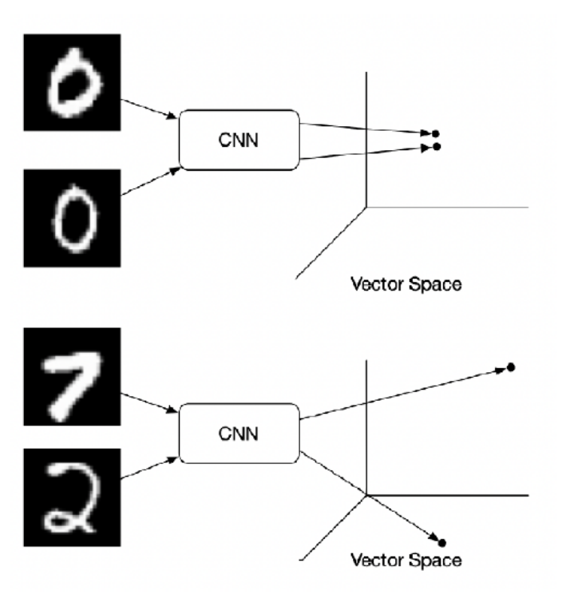
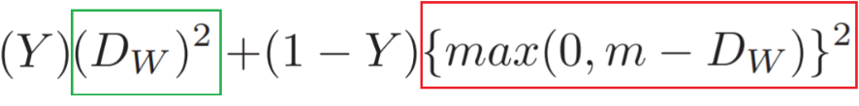
Contrastive Loss
Contrastive loss are computed contrasting two or more data points
D_w is the distance (e.g. Euclidean distance)
between two pairs (by using weights w).
If pairs are similar, then loss is equal to the green
box in loss function.
If pairs are dissimilar, then loss is equal to the red
box in the loss function.
M is the margin
Y is the ground truth label.

Slide 11
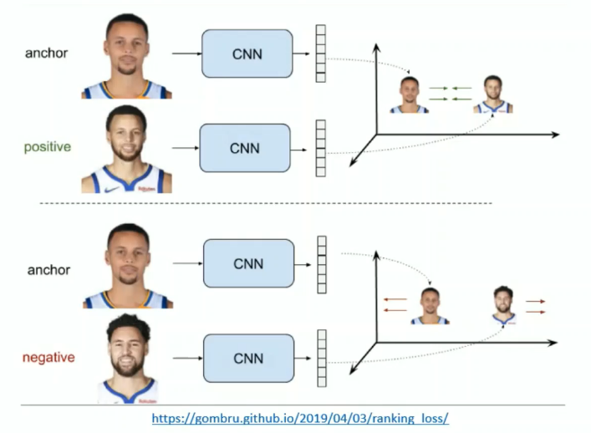
Contrastive Loss

Slide 12
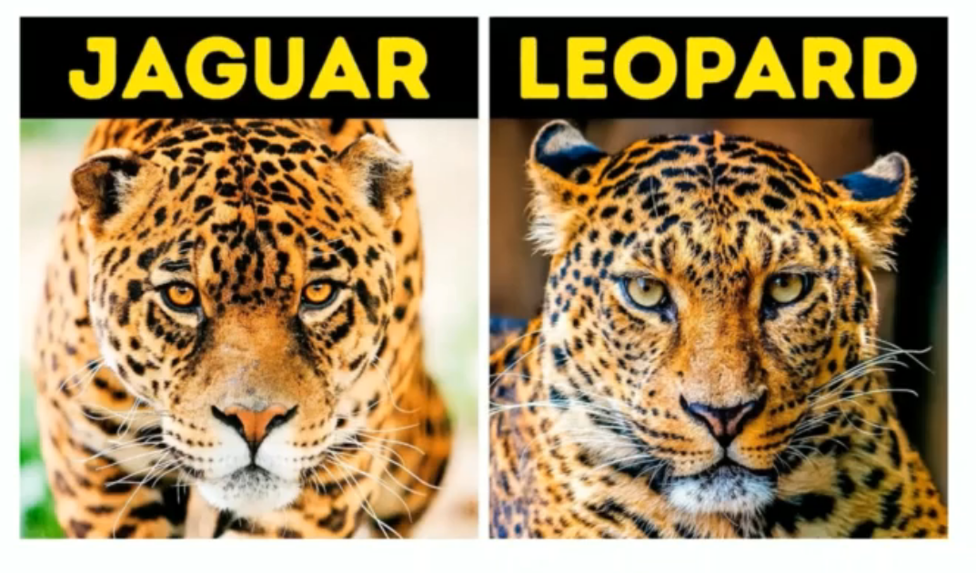
Good Negative Pair

Slide 13
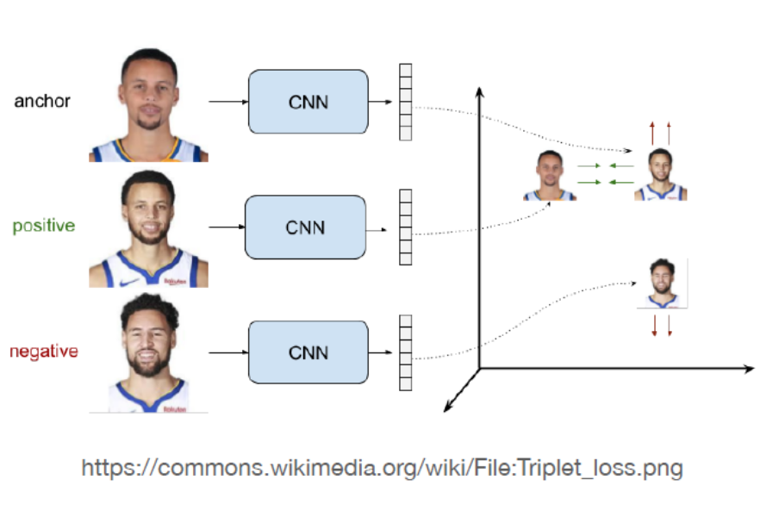

Triplet Ranking Loss
We sample a baseline input. Then, we compare to a positive input (e.g. same face) and a negative input (other face). The distance from the baseline input to the positive input is minimized. The distance from the baseline input to the negative input is maximized.

Slide 14
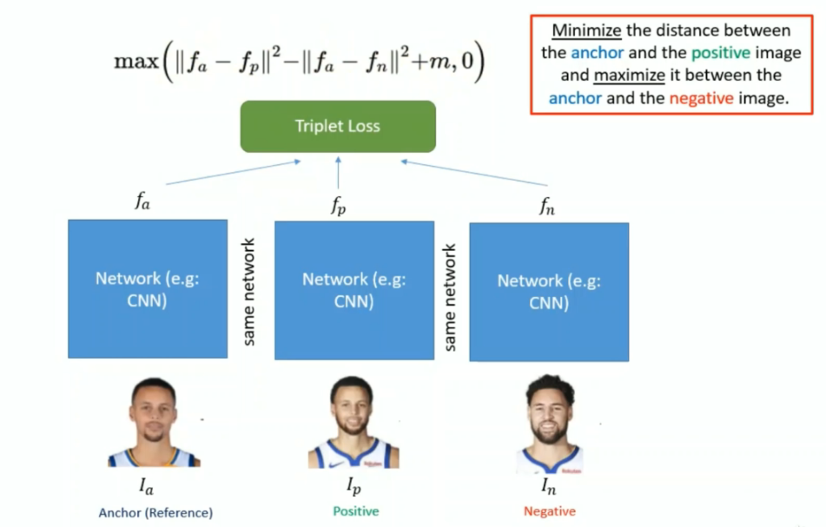
Triplet Loss

Slide 15
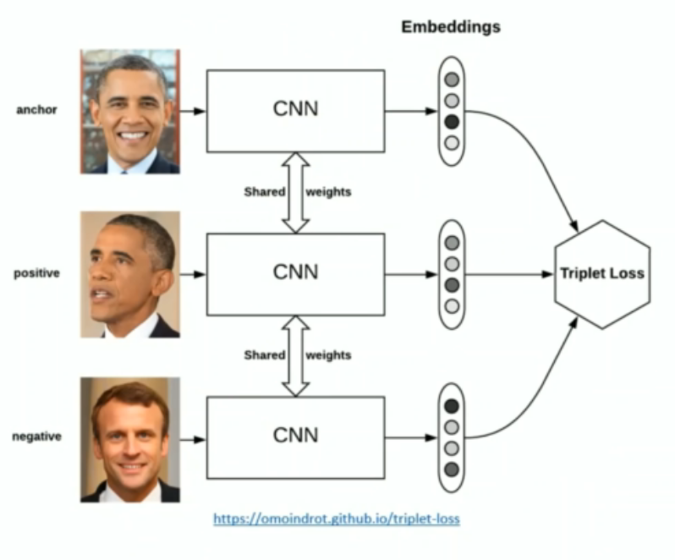
Example

Slide 16
How should we choose the triplets?
Try to select hard negatives

Slide 17
Activation Function
Exponentially Linear Units (ELU)
Swish Activation

Slide 18
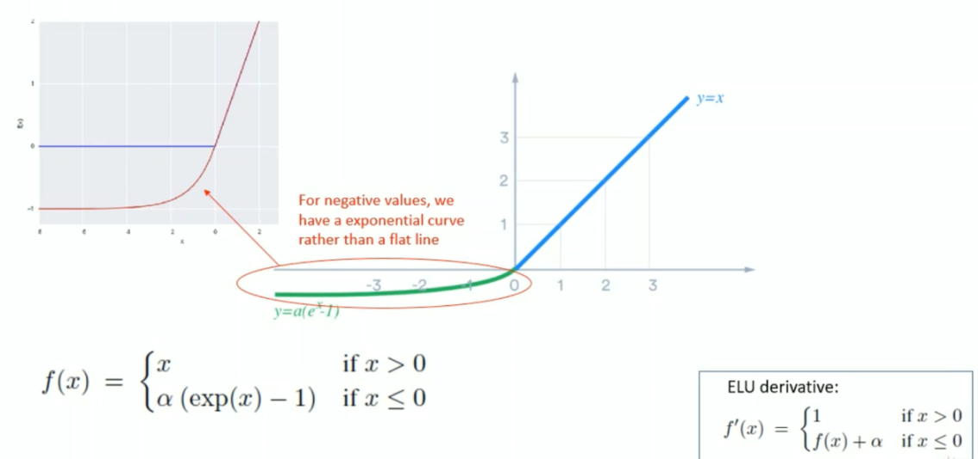
Exponentially Linear Units (ELUs)

Slide 19
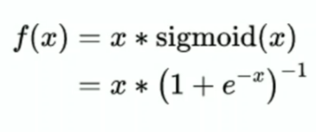
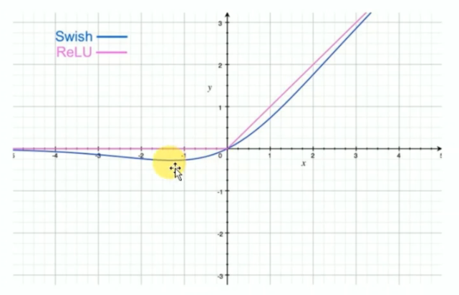
Swish Activation
Swish is a smooth function

Slide 20
Why Swish is better than ReLU?
Sparsity: very negative weights are simply zeroed out
Small negative values are not zeroed out

Slide 21
Optimization
SWATS – Switching from Adam to SGD
Weight Decay
AMSGrad

Slide 22
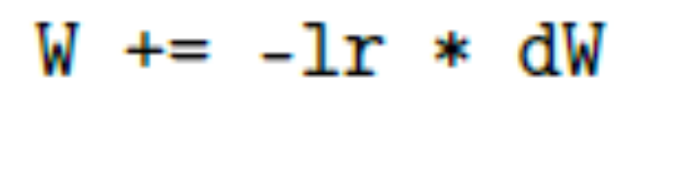
Default SGD weight update
SGD weight update
W is weight matrix
lr is learning rate
dW is the gradient of W

Slide 23
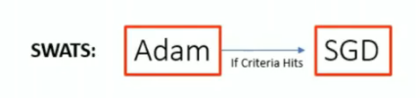
SWATS optimization
In some applications, Adam does not converge to an optimal solution. SGD with momentum gives a better result
Paper “improving Generalization Performance by Switching from Adam to SGD” obtains a better performance

Slide 24
Weight Decay
Weight decay
W = W – lr * dW - lr * α * W
We modify the weight update rule instead of the loss function. At each step, the small portion of the weight will get subtracted
Paper “ A simple weight decay can improve generalization”

Slide 25
AMSGrad
Receive the best paper award in ICLR 2018
Address Adam problem on some applications: short-term memory becomes an obstacle in some scenarios
E.g., some minibatches data are good but happen rarely

Slide 26
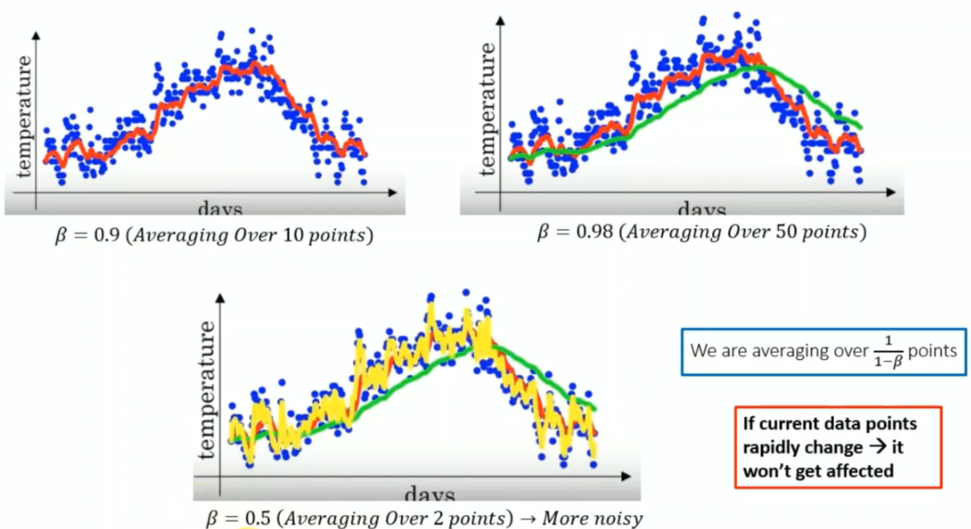
Impact on Beta

Slide 27
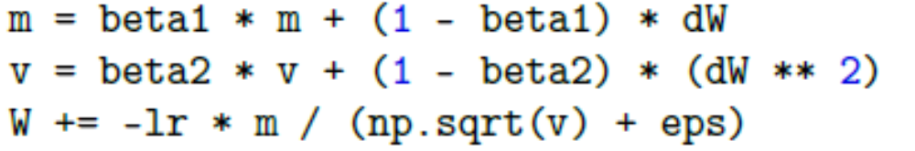
Adam
Adaptive Moment Estimation (Adam) is proposed by Kingman and Ba in 2014
It is similar to RMSprop with momentum added

Slide 28
AMSGrad
Use the maximum between previous weight or the new calculated weight
E.g., for the Adam
m_{t} = beta1 * m_{t-1} + (1-beta1) dW
v_{t} = beta2 * v_{t-1} + (1- beta2 ) dW²
v’_{t} = max(v’_{t-1}, v)
W = W – lr * m_{t} / (sqrt(v’_{t}) + eps)

Slide 29
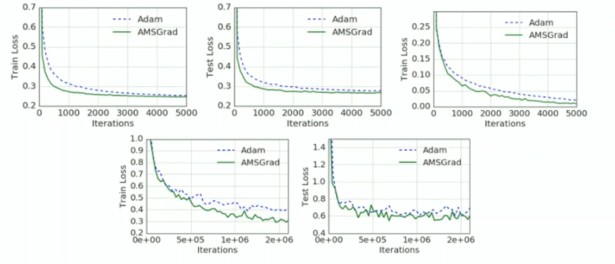
Performance
There is a post mentioned that it is doing well only on small dataset

Slide 30
Normalization
DropConnect
Drop the individual weight instead of dropping a neural [ Wang et al. in 2013]
Layer Normalization
  Normalize the entire layer instead of minimizing the mini-batch, useful in language model. If the input is [w,h,d], the layer normalization compute mean and variance across all d features map for a given input

Slide 31
Question?

